Slide 1
Custom Component Architecture Review Antelope Valley Hospital
Pat Bannerman
Sr Mpages Developer/Instructor
August 4th, 2020

Slide 2
Agenda
What is a Component?
Naming Conventions
General Standards
Static Text Components
Components Utilizing AJAX
Component Properties
Component Options
Appendix

Slide 3
What is a Component?

Slide 4
What is a Component?
“Mini-MPage” within a bigger MPage View.
Self-contained
Does not interact with the framework it’s contained within
The component code itself is called a Javascript class.
The component code implemented/viewed from on the MPage is a Javascript object.

Slide 5
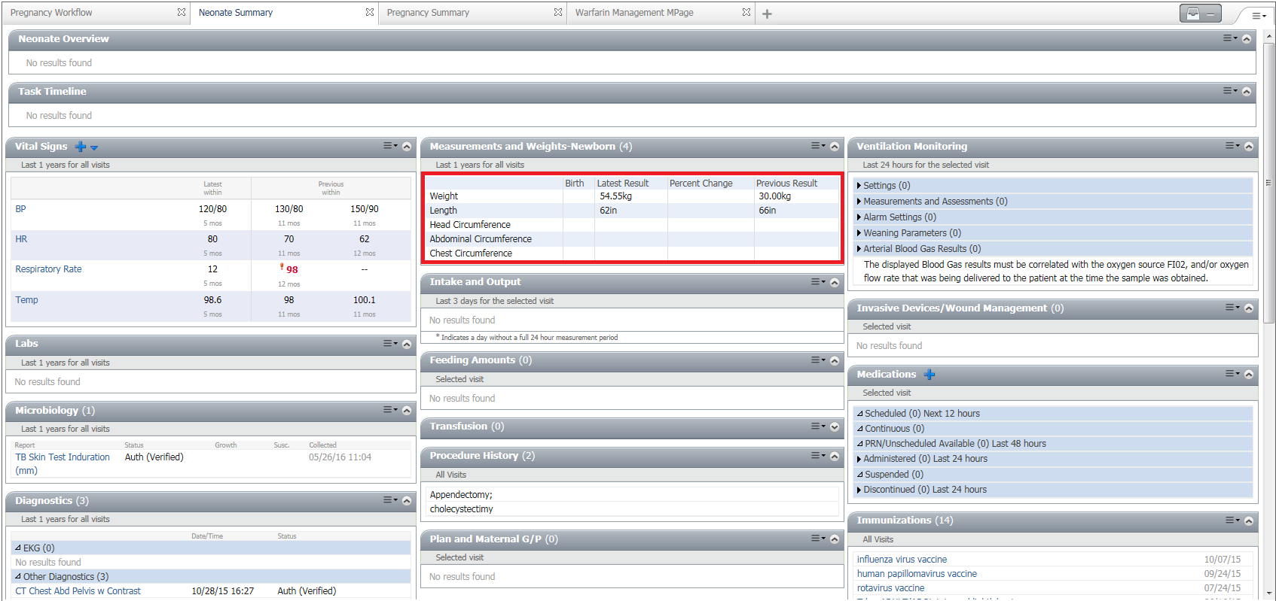
What is a Component?

Slide 6
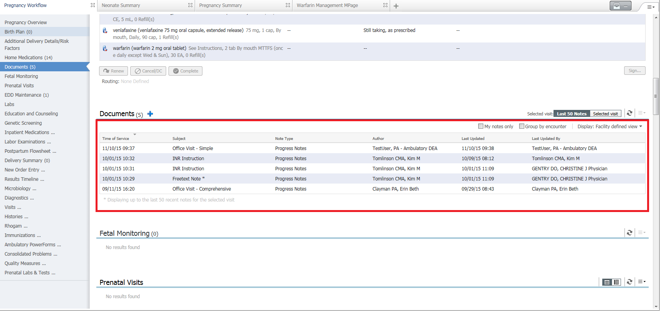
What is a Component?

Slide 7
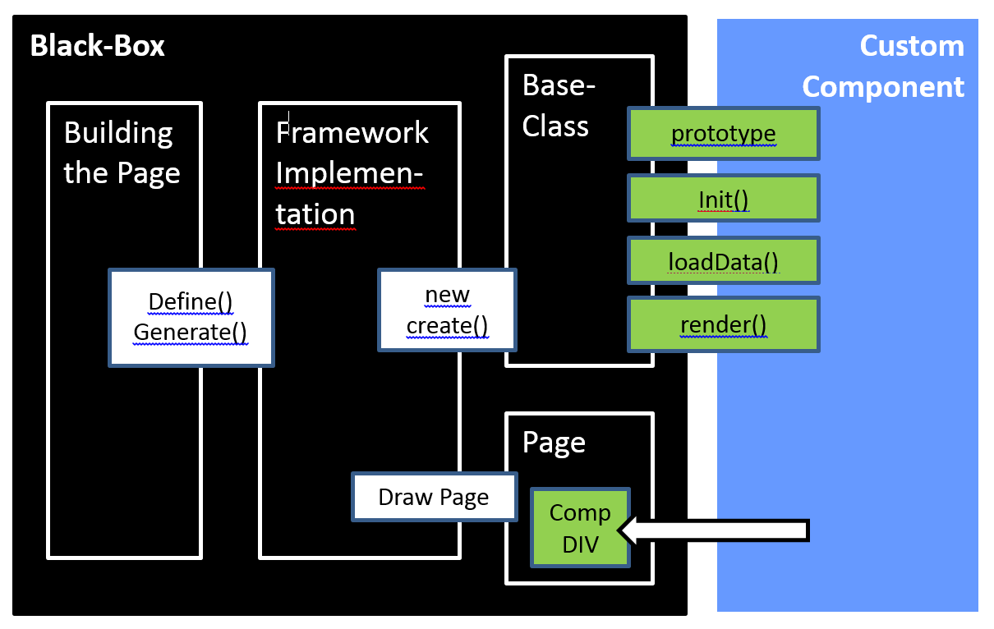
What is a Component?

Slide 8
Naming Conventions

Slide 9
Naming Conventions
Component Development Goal
Ability to support multiple components on a single MPage without having them inadvertently interact with each other causing unintended results.

Slide 10
Naming Conventions (Rules)
Determine a mnemonic to begin all strings for classes, element names, etc. (ie CERN_KC)
If you must create an element id, consider using the following to pull the component unique identifier and attaching it with some other text
var eleId = this.getComponentUid()+"_ele_1";
NEVER define a class at the element level
table {border:1px solid #00000;}

Slide 11
Naming Conventions (Exceptions)
If the class name is supported by an external library, we have no control over it so leave it as is (ie jQuery plugins)
If the class name is “Common CSS” name supplied with the framework you are working in, you can use it without restriction.
Note: Be careful using these as implementation of newer browsers, MPage versions, jQuery versions, etc will require regression testing.

Slide 12
General Standards

Slide 13
General Standards
Your code will ALWAYS begin with the following:
MPage.namespace("my.namespace");
my.namespace.prototype = new MPage.Component();
my.namespace.prototype.constructor = MPage.Component;
my.namespace.prototype.base = MPage.Component.prototype;
my.namespace.prototype.name = "my.namespace";
This allows for inheritance of the MPage Component base class which allows access to the properties mentioned previously as well as helper functions to launch your component.

Slide 14



General Standards
Base-class built as part of the framework you are using
Internal logic and programming may differ framework to framework
Functionality exposed for your component to use will always be the same

Slide 15
Best Practices
No direct DOM injection outside of the component container unless with identified exceptions (hovers)
External libraries should only be included directly into custom-components.js. Dynamic script requests could block entire page.
Avoid using global static references to store state values. Instead use variables prototyped as part of the object instance.
You can also use the “userPreferences” property to store user preferences string as of 1.1 (MPages V6.x)
this.setProperty("userPreferences",'{"str":"hello"}');

Slide 16
Static Text Components

Slide 17
Static Text Components
MPage.namespace("my.namespace");
my.namespace.prototype = new MPage.Component();
my.namespace.prototype.constructor = MPage.Component;
my.namespace.prototype.base = MPage.Component.prototype;
my.namespace.prototype.name = "my.namespace";
my.namespace.prototype.render = function() {
var target = this.getTarget();
target.innerHTML = "Hello World!";
};

Slide 18
Static Text Components
my.namespace.prototype.render = function() {
var target = this.getTarget();
target.innerHTML = "Hello World!";
};
The render function is used to display HTML to the component container.
If you do not override, the default behavior will be to do nothing.

Slide 19
Static Text Components
my.namespace.prototype.render = function() {
var target = this.getTarget();
target.innerHTML = "Hello World!";
};
getTarget function returns the DOM (document object model) object of the component container
This function SHOULD NOT be used/called anywhere but the render function

Slide 20
Static Text Components
my.namespace.prototype.render = function() {
var target = this.getTarget();
target.innerHTML = "Hello World!";
};
innerHTML is a DOM property of an element to insert content to an element.
You must assume that the target element being used will always be a DOM object.
You should NEVER render content outside of the DOM target object without using exposed methods to do so!!!

Slide 21
Components Utilizing AJAX

Slide 22
Components Utilizing AJAX
MPage.namespace("my.namespace");
my.namespace.prototype = new MPage.Component();
my.namespace.prototype.constructor = MPage.Component;
my.namespace.prototype.base = MPage.Component.prototype;
my.namespace.prototype.name = "my.namespace";
my.namespace.prototype.init = function() {
this.cclProgram = "1_myorg_get_data";
this.cclParams[0] = "MINE";
this.cclParams[1] = this.getProperty("personId");
this.cclParams[2] = "LABORATORY";
this.cclDataType = "TEXT";
};
my.namespace.prototype.render = function() {
var target = this.getTarget();
target.innerHTML = this.data;
};

Slide 23
Components Utilizing AJAX
my.namespace.prototype.init = function() {
this.cclProgram = "1_myorg_get_data";
this.cclParams[0] = "MINE";
this.cclParams[1] = this.getProperty("personId");
this.cclParams[2] = "LABORATORY";
this.cclDataType = "TEXT";
};
my.namespace.prototype.render = function() {
var target = this.getTarget();
target.innerHTML = this.data;
};
Init function should be overridden to set-up a CCL call.
If you do not override, the default behavior will be to do nothing.

Slide 24
Components Utilizing AJAX
my.namespace.prototype.init = function() {
this.cclProgram = "1_myorg_get_data";
this.cclParams[0] = "MINE";
this.cclParams[1] = this.getProperty("personId");
this.cclParams[2] = "LABORATORY";
this.cclDataType = "TEXT";
};
my.namespace.prototype.render = function() {
var target = this.getTarget();
target.innerHTML = this.data;
};
The cclProgram property defines what CCL program will be called
If not defined, the component framework will assume this is a static component and not call anything.

Slide 25
Components Utilizing AJAX
my.namespace.prototype.init = function() {
this.cclProgram = "1_myorg_get_data";
this.cclParams[0] = "MINE";
this.cclParams[1] = this.getProperty("personId");
this.cclParams[2] = "LABORATORY";
this.cclDataType = "TEXT";
};
my.namespace.prototype.render = function() {
var target = this.getTarget();
target.innerHTML = this.data;
};
Property of cclParams is an array used to define the prompts for the CCL program
All strings will have “^” wrapped around them, and all numbers will be created as floats.
We will discuss function getProperty later

Slide 26
Components Utilizing AJAX
my.namespace.prototype.init = function() {
this.cclProgram = "1_myorg_get_data";
this.cclParams[0] = "MINE";
this.cclParams[1] = this.getProperty("personId");
this.cclParams[2] = "LABORATORY";
this.cclDataType = "TEXT";
};
my.namespace.prototype.render = function() {
var target = this.getTarget();
target.innerHTML = this.data;
};
Property of cclDataType in init determines the data type for the data property in render.
cclDataType can be “TEXT”, “XML”, or “JSON” (default). The framework will take the string from the response and parse accordingly.

Slide 27
Component Properties

Slide 28
Component Properties (Required)
Patient ID ➔ PERSON.PERSON_ID
this.getProperty("personId")
Encounter ID ➔ ENCOUNTER.ENCNTR_ID
this.getProperty("encounterId")
User ID ➔ PRSNL.PERSON_ID
this.getProperty("userId")

Slide 29
Component Properties (Optional)
PPR Code ➔PERSON_PRSNL_RELTN.PERSON_PRSNL_R_CD
this.getProperty("PPRCode")
Position Code ➔ PRSNL.POSITION_CD
this.getProperty("positionCd")
Static Content Location ➔ determined by prompt passed
this.getProperty("staticContent")
Note: If property is not found with optional properties, function will return the string “undefined”

Slide 30
Component Properties (Optional)
Component Header Title ➔ can use setProperty also
this.getProperty("headerTitle")
Component Sub Header ➔ can use setProperty also
this.getProperty("headerSubTitle")
Component Collapse/Expand ➔ can use setProperty also
this.getProperty("headerShowHideState")
DON’T USE COLLAPSE/EXPAND PROPERTY WITH WORKFLOW COMPONENTS!! It will throw an error.

Slide 31
Component Options

Slide 32
Component Options
Previous examples were meant to do one thing and one thing only
Sometimes you need a way to refactor/reuse code such that it can perform multiple ways.
Use Cases
You might need a previously used component with different CCL parameters passed
You might need a previously used component with different visual display based on data passed
You could just create two copies of the component and modify slightly, but this is BAD programming practice!

Slide 33
Components Options
Take the following code:
my.namespace.prototype.init = function() {
this.cclProgram = "1_myorg_get_data";
this.cclParams[0] = "MINE";
this.cclParams[1] = this.getProperty("personId");
this.cclParams[2] = "LABORATORY";
this.cclDataType = "TEXT";
};
my.namespace.prototype.render = function() {
var target = this.getTarget();
target.innerHTML = this.data;
};

Slide 34
Components Options
Add in a static variable using our namespace (note that no “prototype” was used to make it static):
my.namespace.option1 = {"ACTIVITY_TYPE":"LABORATORY"};
my.namespace.prototype.init = function() {
this.cclProgram = "1_myorg_get_data";
this.cclParams[0] = "MINE";
this.cclParams[1] = this.getProperty("personId");
this.cclParams[2] = "LABORATORY";
this.cclDataType = "TEXT";
};
my.namespace.prototype.render = function() {
var target = this.getTarget();
target.innerHTML = this.data;
};

Slide 35
Components Options
Update to the data being passed as parameters (note that the options for the component are updated by the framework as the class is instantiated):
my.namespace.option1 = {"ACTIVITY_TYPE":"LABORATORY"};
my.namespace.prototype.init = function() {
this.cclProgram = "1_myorg_get_data";
this.cclParams[0] = "MINE";
this.cclParams[1] = this.getProperty("personId");
this.cclParams[2] = this.options.ACTIVITY_TYPE;
this.cclDataType = "TEXT";
};
my.namespace.prototype.render = function() {
var target = this.getTarget();
target.innerHTML = this.data;
};

Slide 36
Components Options
Multiple options can now be created, and flexed based off which static object is used to instantiate the object in the framework:
my.namespace.option1 = {"ACTIVITY_TYPE":"LABORATORY"};
my.namespace.option2 = {"ACTIVITY_TYPE":"PHARMACY"};
my.namespace.prototype.init = function() {
this.cclProgram = "1_myorg_get_data";
this.cclParams[0] = "MINE";
this.cclParams[1] = this.getProperty("personId");
this.cclParams[2] = this.options.ACTIVITY_TYPE;
this.cclDataType = "TEXT";
};
my.namespace.prototype.render = function() {
var target = this.getTarget();
target.innerHTML = this.data;
};

Slide 37
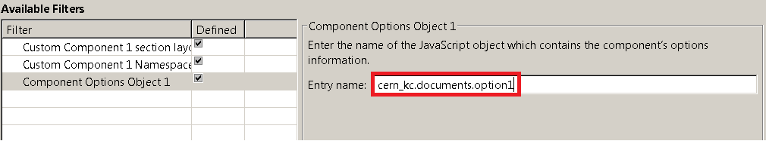
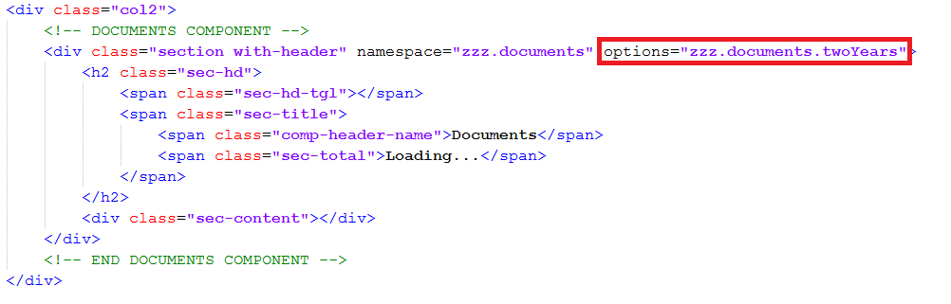
Components Options
Here are how the options are typically pulled in using standard MPages
Here is an example of a custom framework doing the same, but through custom meta tags in the HTML

Slide 38
Components Options (rules)
The options property will contain a JSON compliant object based upon the options configured for that component
The component should NOT assume all of the options are entered, and should check for the existence before using or merge the options object with a default options object.
ie. the field for options in Bedrock is optional and can be left blank
The structure of the options object should be the exact same for each one created. This will prevent from having to have error/field checking on each field used.

Slide 39
Appendix

Slide 40
Appendix (Version 6.x configuration)
Report Name
mp_unified_driver
Report Params (note that static content path should be set to blank for pulling code off webservice)
"MINE", $PAT_PERSONID$, $VIS_ENCNTRID$, $USR_PERSONID$, $USR_PositionCd$, $PAT_PPRCode$, "$APP_AppName$", "<fileshare or mapped drive>\\WININTEL\\static_content\\MPAGES_6_0|", "<view builder or viewpoint builder identifier>"
Custom Component Filepath using above reference (DO NOT USE AS REFERENCE IN REPORT PARAMS)
<fileshare or mapped drive>\WININTEL\static_content\MPAGES_6_0\custom_mpage_content\custom-components
Note: Copy the custom_mpage_content folder into MPAGES_6_0 folder if referencing from code warehouse.
Pipe is now required when static content referenced

Slide 41
Appendix (Version 5.x configuration)
Report Name
mp_unified_driver
Report Params (note that static content path should be set to blank for pulling code off webservice)
"MINE", $PAT_PERSONID$, $VIS_ENCNTRID$, $USR_PERSONID$, $USR_PositionCd$, $PAT_PPRCode$, "$APP_AppName$", "<fileshare or mapped drive>\\WININTEL\\static_content\\UnifiedContent", "<view builder or viewpoint builder identifier>"
Custom Component Filepath (DO NOT USE AS REFERENCE IN REPORT PARAMS)
<fileshare or mapped drive>\WININTEL\static_content\custom_mpage_content\custom-components

Slide 42
Appendix (cont.)
MPages Overview
MPages Style Guide
MPages Development Wiki
MPages Technical Development Group

Slide 43
Reference
“How to Build an MPage Component In 10 Easy Steps”
– David Stone

